Slide 1

Effectiveness of Tree-Based Models in Predicting Student Success
Mike Ogrysko

Slide 2
Project Introduction
This analysis will focus on the usage of tree-based models to predict higher-education student success.
The data used in this analysis will be a 2019 study of Cyprian engineering and educational sciences students, which has been gathered specifically to be used with machine learning techniques to predict end-of-term performances.
The dataset features 145 student records and 31 predictors that fall into three categories: personal information (e.g., age, sex, relationship status, etc.), family information (e.g., parents’ education and occupation, number of siblings, etc.), and educational habits (e.g., study hours, type of exam prep, classroom behaviors, etc.).
In addition, the dataset includes response data – students’ final grade.
All prediction and response data have been converted to numeric categorical values.
Data source: http://archive.ics.uci.edu/ml/datasets/Higher+Education+Students+Performance+Evaluation+Dataset

Slide 3
Project Data – Predictors – Personal Data
# | Predictor | Categories
1 | Student age | 1: 18-21, 2: 22-25, 3: above 26
2 | Sex | 1: female, 2: male
3 | Graduated high school type | 1: private, 2: state, 3: other
4 | Scholarship type | 1: None, 2: 25%, 3: 50%, 4: 75%, 5: Full
5 | Additional work | 1: Yes, 2: No
6 | Regular artistic /sports activity | 1: Yes, 2: No
7 | Do you have a partner? | 1: Yes, 2: No
8 | Total salary if available | 1: USD 135-200, 2: USD 201-270, 3: USD 271-340, 4: USD 341-410, 5: above 410
9 | Transportation to university | 1: Bus, 2: Private car/taxi, 3: bicycle, 4: Other
10 | Accommodation type in Cyprus | 1: rental, 2: dormitory, 3: with family, 4: Other

Slide 4
Project Data – Predictors – Family Data
# | Predictor | Categories
11 | Mother’s education | 1: primary school, 2: secondary school, 3: high school, 4: university, 5: MSc., 6: Ph.D.
12 | Father’s education | 1: primary school, 2: secondary school, 3: high school, 4: university, 5: MSc., 6: Ph.D.
13 | Number of sisters/brothers | 1: 1, 2:, 2, 3: 3, 4: 4, 5: 5 or above
14 | Parental status | 1: married, 2: divorced, 3: died - one of them or both
15 | Mother’s occupation | 1: retired, 2: housewife, 3: government officer, 4: private sector employee, 5: self-employment, 6: other
16 | Father’s occupation | 1: retired, 2: government officer, 3: private sector employee, 4: self-employment, 5: other

Slide 5
Project Data – Predictors – Educational Habits
# | Predictor | Categories
17 | Weekly study hours | 1: None, 2: <5 hours, 3: 6-10 hours, 4: 11-20 hours, 5: more than 20 hours
18 | Reading frequency (non-scientific books/journals) | 1: None, 2: Sometimes, 3: Often
19 | Reading frequency (scientific books/journals) | 1: None, 2: Sometimes, 3: Often
20 | Attendance to the seminars/conferences related to the department | 1: Yes, 2: No
21 | Impact of your projects/activities on your success | 1: positive, 2: negative, 3: neutral
22 | Attendance to classes | 1: always, 2: sometimes, 3: never
23 | Preparation to midterm exams 1 | 1: alone, 2: with friends, 3: not applicable
24 | Preparation to midterm exams 2 | 1: closest date to the exam, 2: regularly during the semester, 3: never
25 | Taking notes in classes | 1: never, 2: sometimes, 3: always

Slide 6
Project Data – Predictors – Educational Habits, continued
# | Predictor | Categories
26 | Listening in classes | 1: never, 2: sometimes, 3: always
27 | Discussion improves my interest and success in the course | 1: never, 2: sometimes, 3: always
28 | Flip-classroom | 1: not useful, 2: useful, 3: not applicable
29 | Cumulative grade point average in the last semester (/4.00) | 1: <2.00, 2: 2.00-2.49, 3: 2.50-2.99, 4: 3.00-3.49, 5: above 3.49
30 | Expected Cumulative grade point average in the graduation (/4.00) | 1: <2.00, 2: 2.00-2.49, 3: 2.50-2.99, 4: 3.00-3.49, 5: above 3.49

Slide 7
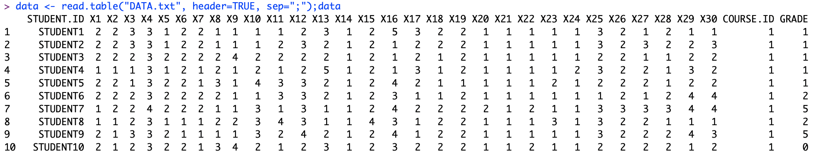
Project Data – Response and Other Notes
GRADE | 0: Fail, 1: DD, 2: DC, 3: CC, 4: CB, 5: BB, 6: BA, 7: AA
On import, data also includes Student ID and Course ID, both have been dropped – 30 predictors will be used.
On import, predictors are imported with names X1, X2,…, X30. Column names have been replaced with text-based names that align with the predictor.
Predictor and response data are all integers and have been converted to factors.

Slide 8
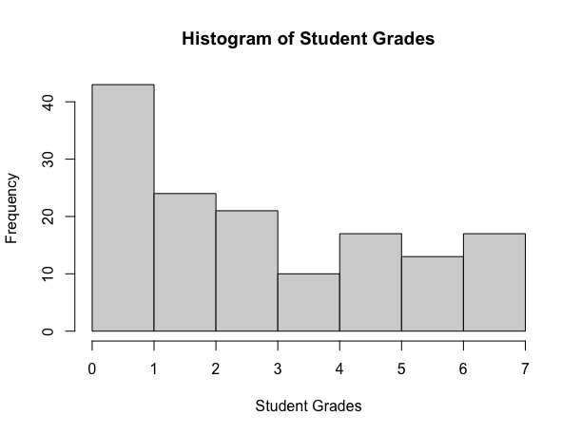
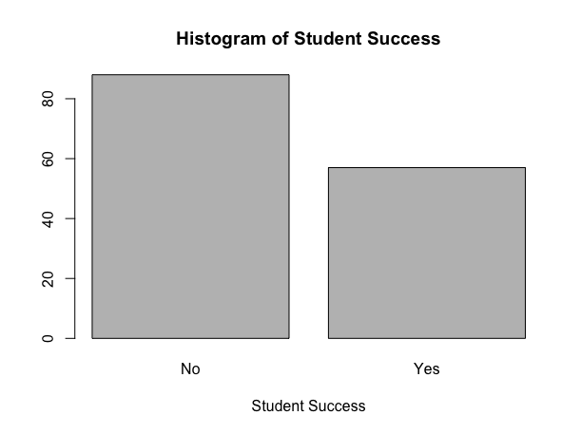
Project Data – Response and Other Notes, continued
For use in classification trees, SUCCESS has been added:
”Yes” – the grade range is B- to A (4-7)
“No” - the grade range is F to C (0-3)
GRADE has been dropped
hist(data$GRADE, main="Histogram of Student Grades", xlab="Student Grades")
plot(factor(SUCCESS), main="Histogram of Student Success", xlab="Student Success")

Slide 9
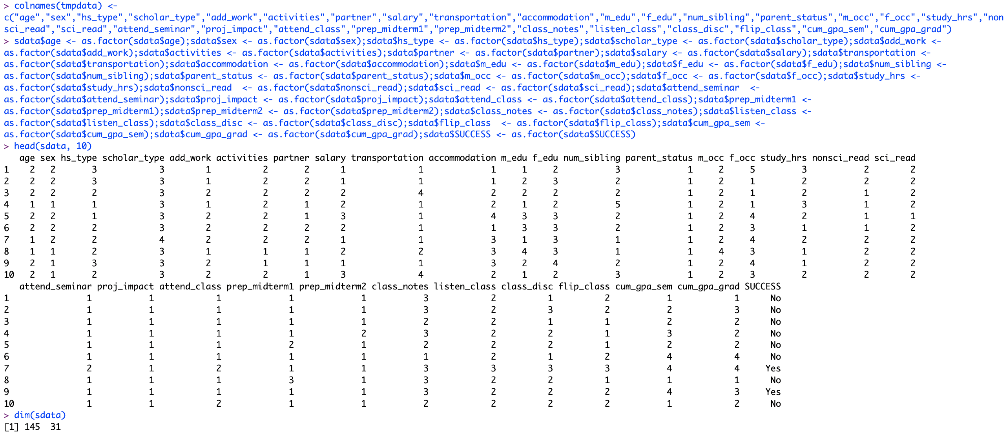
Project Data Processing

Slide 10
Project Questions
How effective are tree-based models in classifying student success?
Reminder: We are using the given grades to establish a range for success – B- to A is “Yes” and F to C is “No”
Which predictors are most important in predicting student success?

Slide 11
Analysis Introduction
For this analysis, we will use the following models:
Decision tree
Decision tree with pruning
Random forest

Slide 12
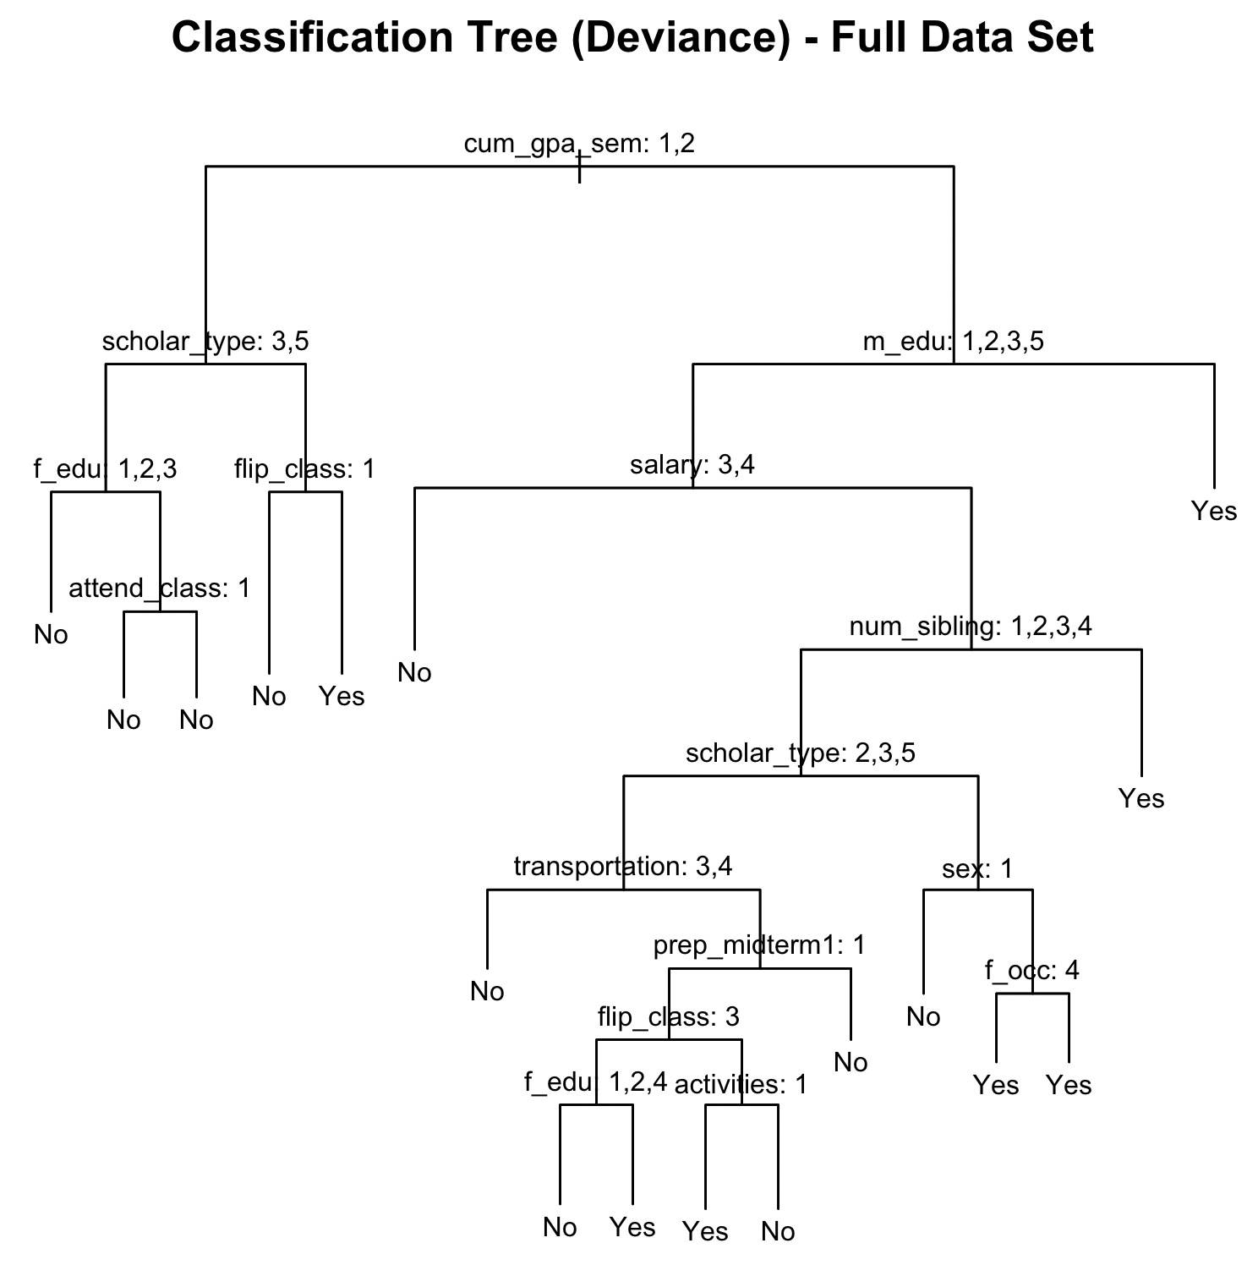
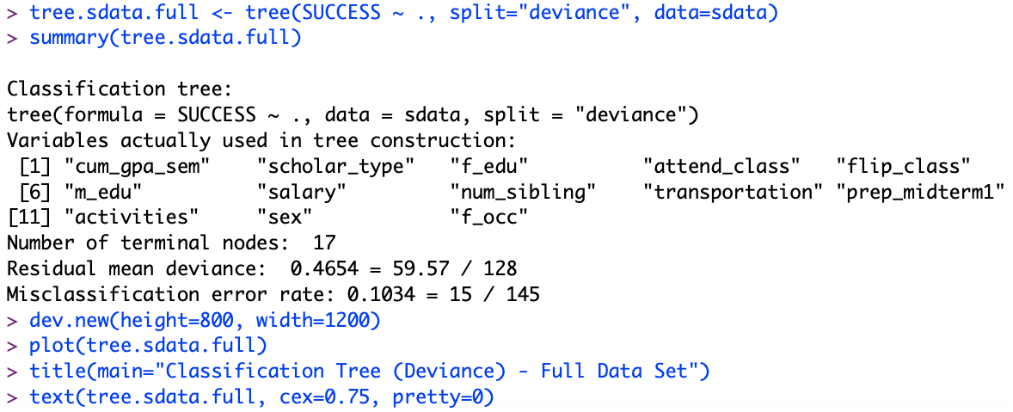
Analysis – Decision Tree
Fit the full dataset into the decision tree
17 terminal nodes
15/145 have been misclassified for a 10.34% misclassification error rate
Cumulative GPA from the previous semester is the most important predictor

Slide 13
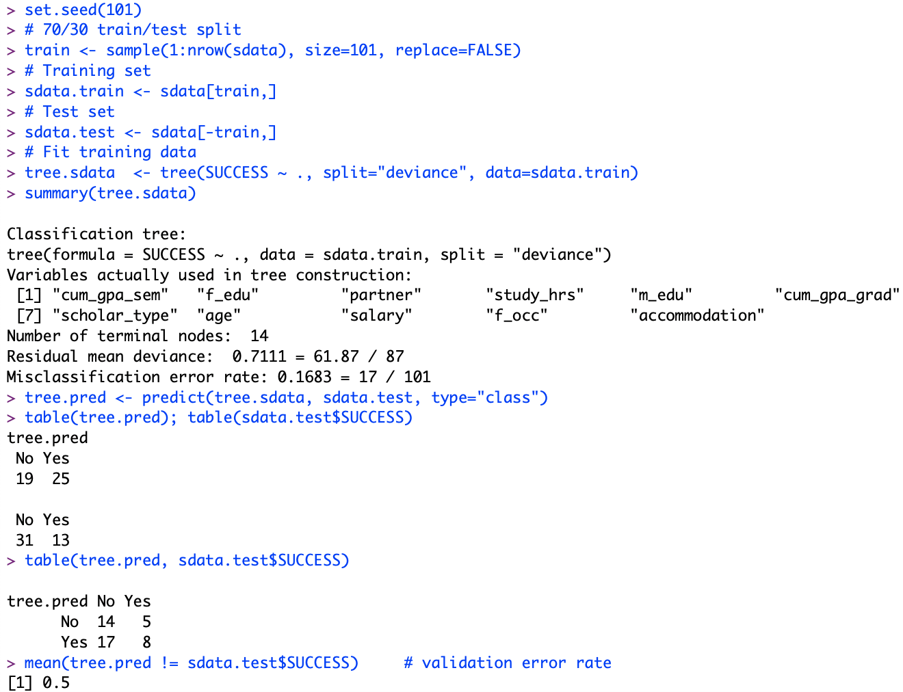
Analysis – Decision Tree Train/Test Split
70/30 train/test dataset into the decision tree
Training set misclassification error rate is 16.83% (17/101) and 14 terminal nodes
Fitting the test set results in validation error rate of 50%

Slide 14
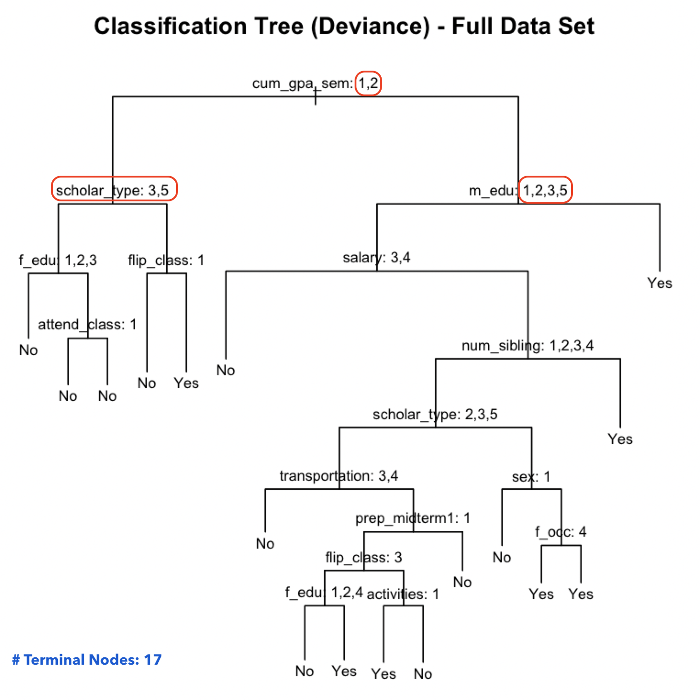
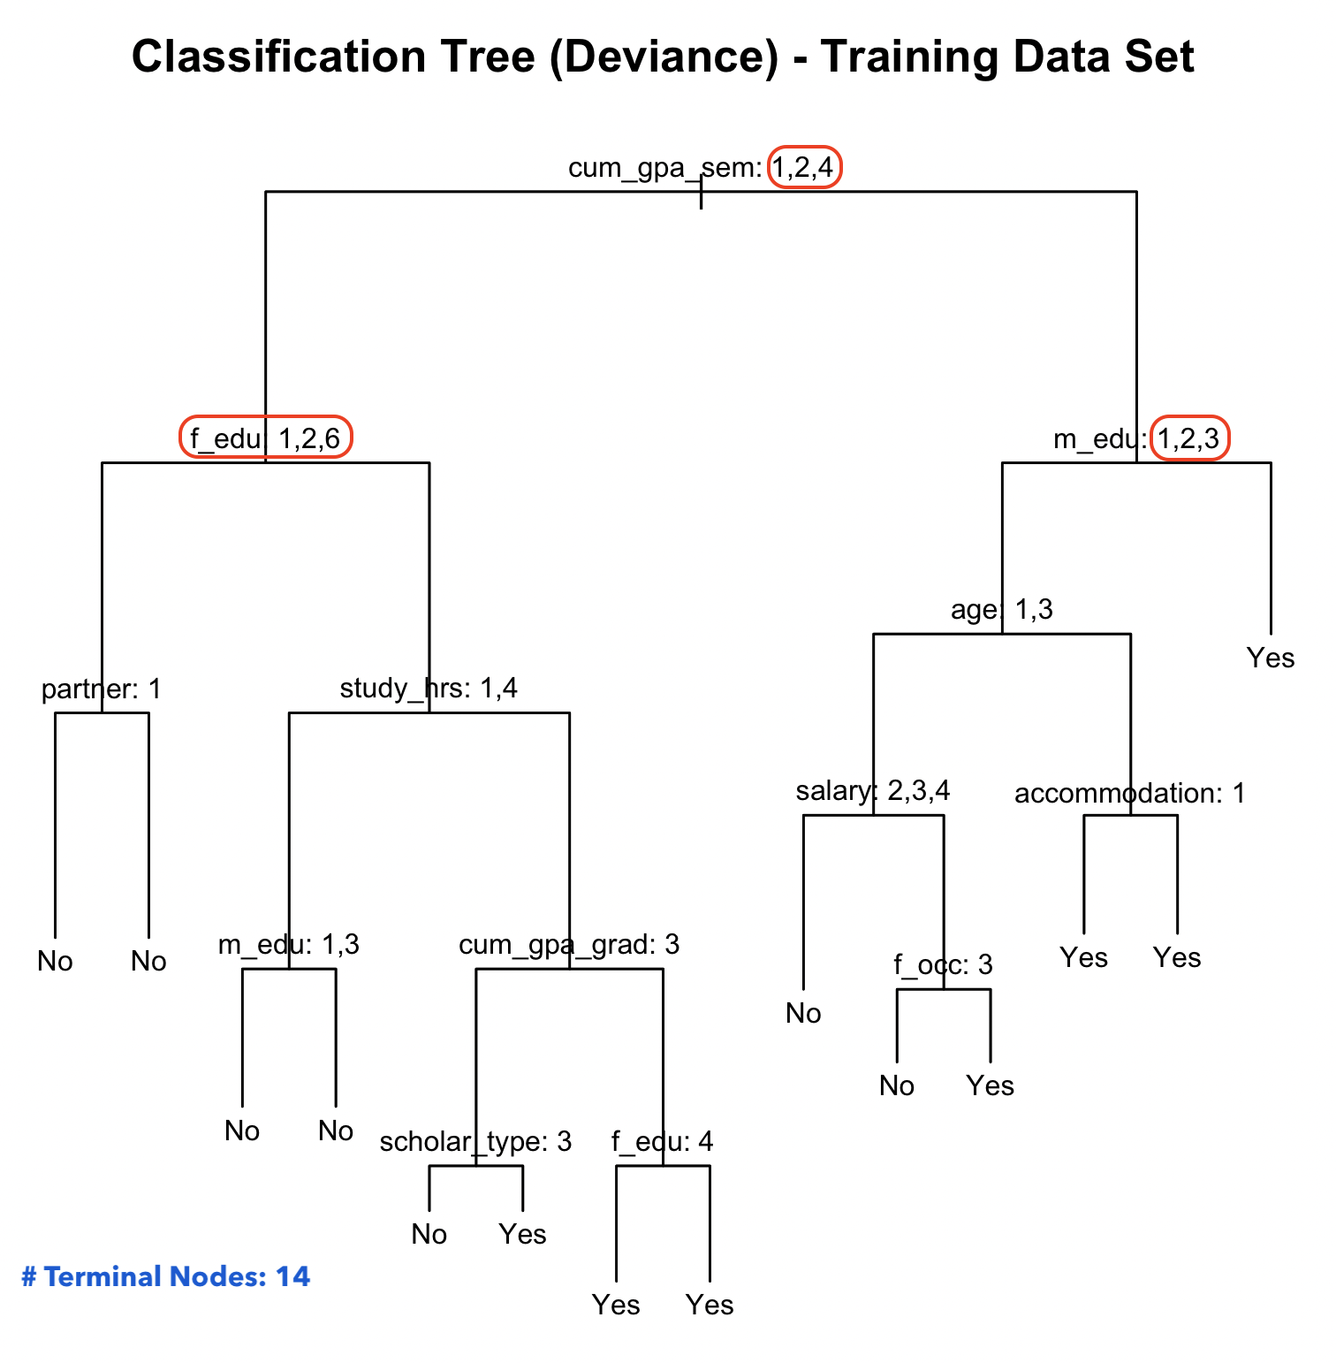
Analysis – Decision Tree Train/Test Split, continued
Terminal nodes shift from 17 to 14
Cumulative GPA from previous semester is still most important
Additional value: 4: 3.00-3.49
Tree now splits to Father’s education – a change from Scholarship type
Mother’s education drops 5: MSc. in the new tree

Slide 15
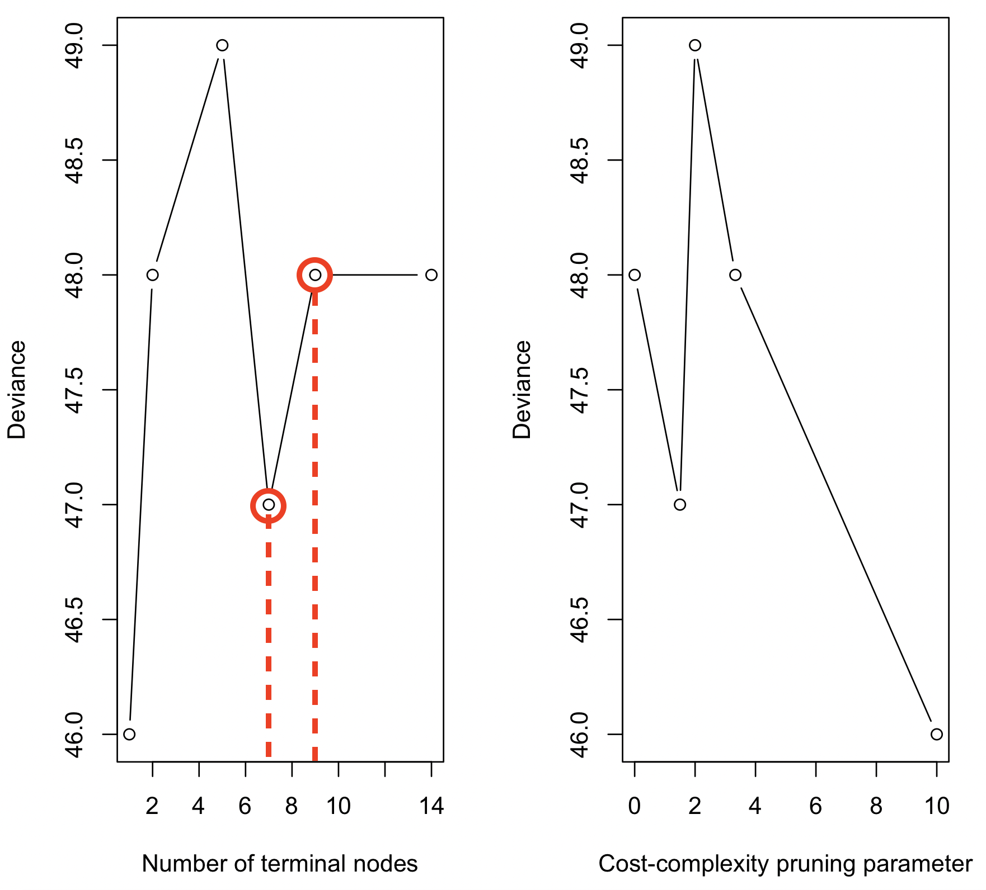
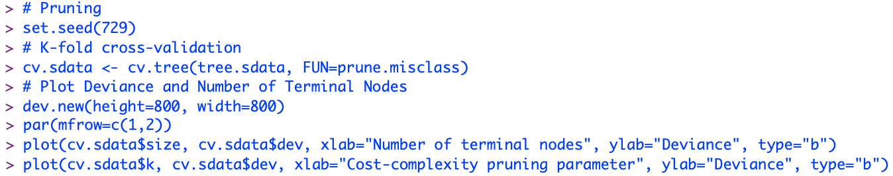
Analysis – Decision Tree with Pruning
K-fold cross validation to obtain best level of tree complexity
Looking at the drop on the plot, the best options for terminal nodes are 7 and 9

Slide 16
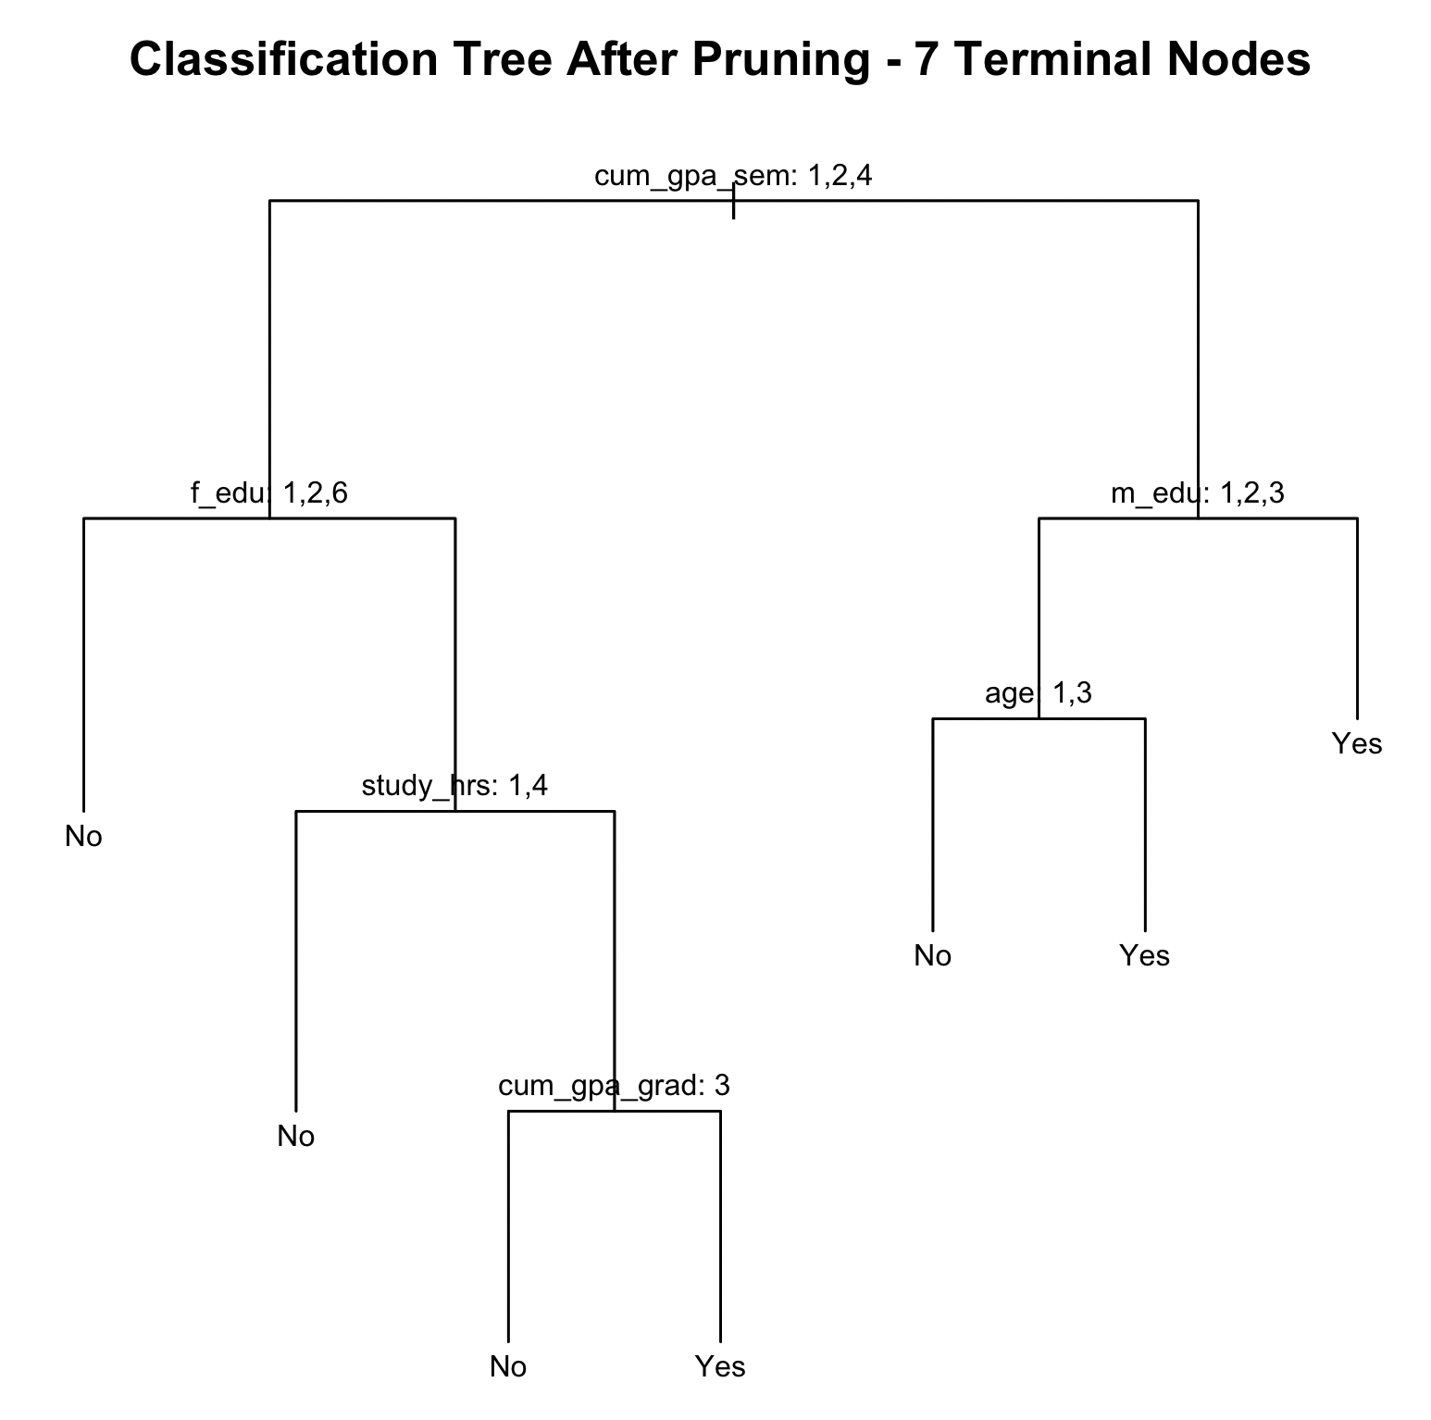
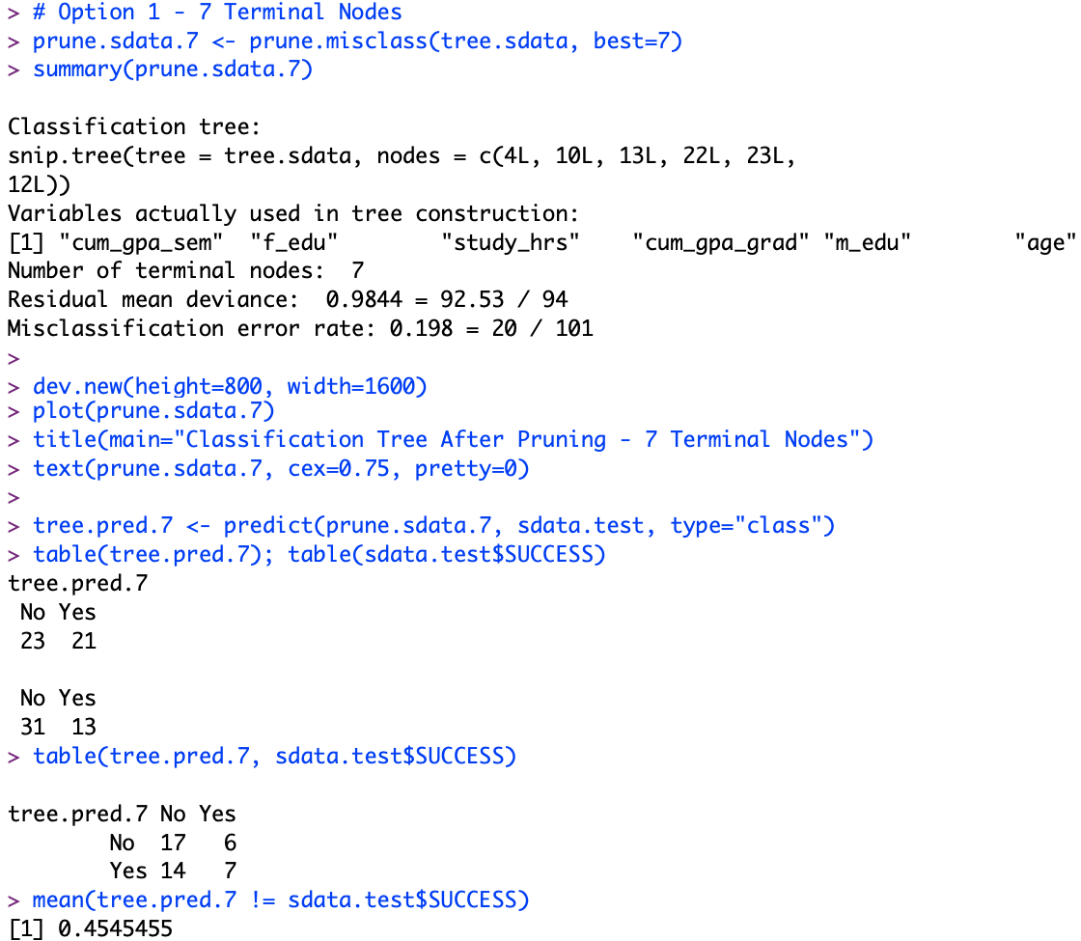
Analysis – Decision Tree with Pruning, 7 Terminal Nodes
Pruned tree: 19.8% (20/101) misclassification error rate
Evaluated pruned tree on test set: 45.4% validation error rate
Cumulative GPA from previous semester continues to be the most important predictor

Slide 17
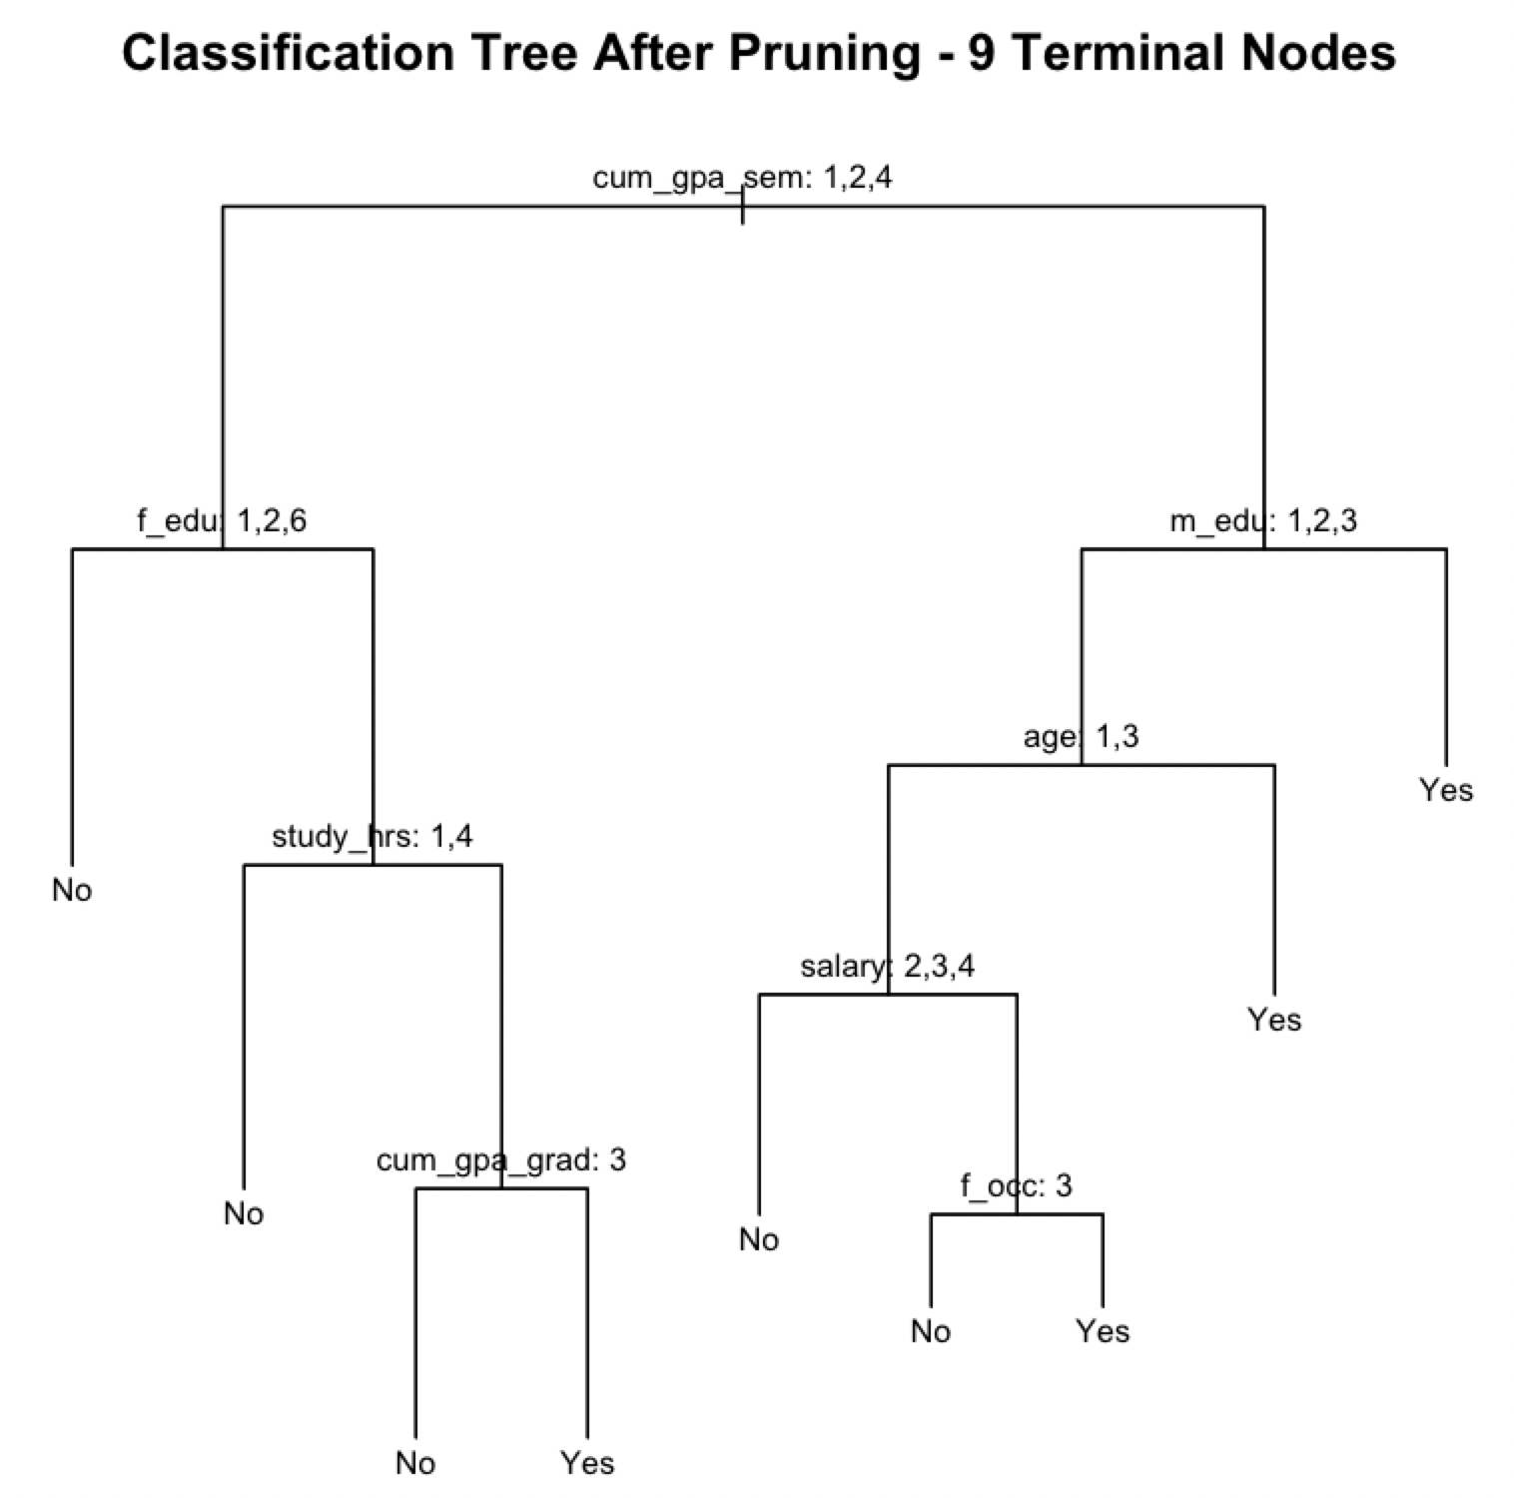
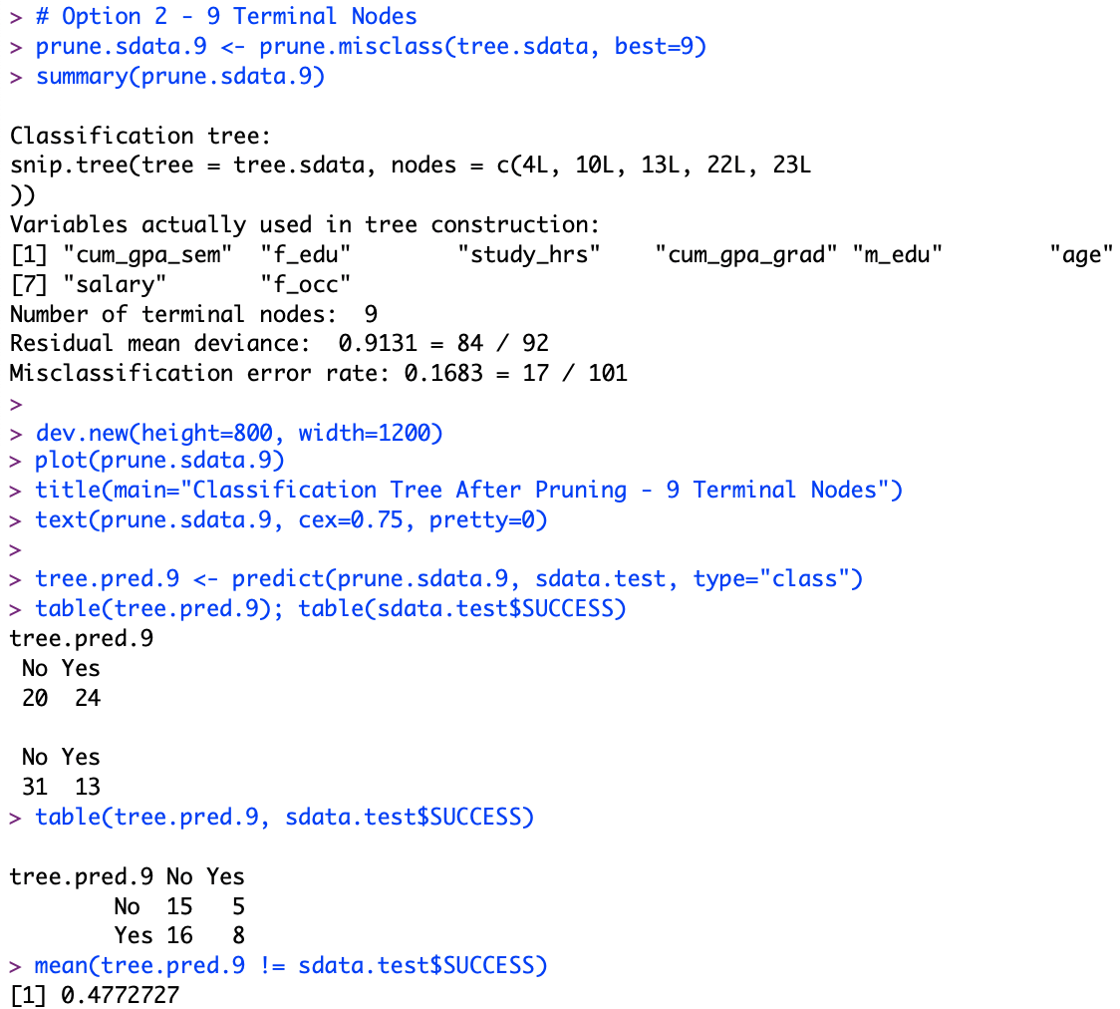
Analysis – Decision Tree with Pruning, 9 Terminal Nodes
Pruned tree: 16.83% (17/101) misclassified error rate
Evaluated pruned tree on test set: 47.72% validation error rate
Cumulative GPA from previous semester continues to be the most important predictor

Slide 18
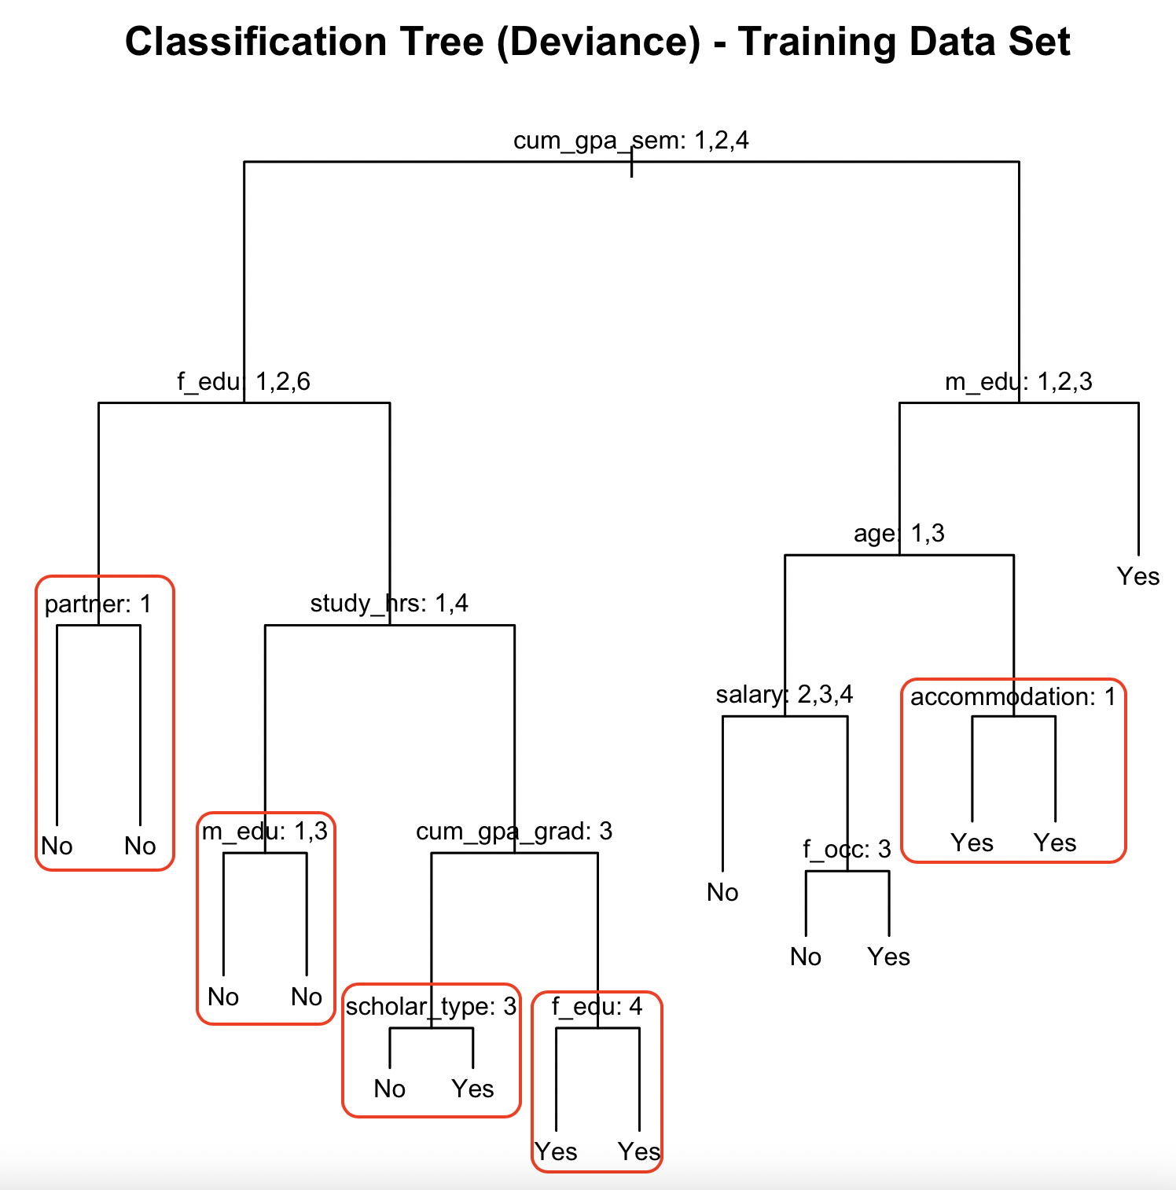
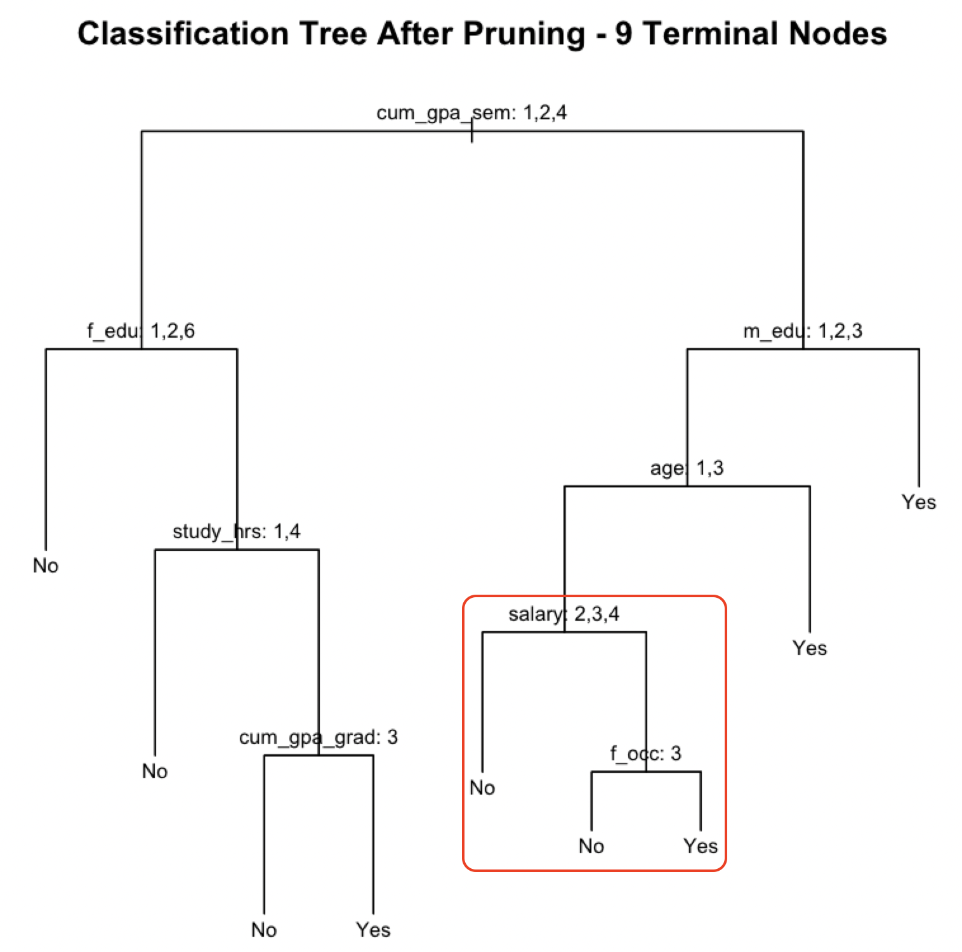
Analysis – Comparing the Trees
Prune from 14 to 9 to 7 terminal nodes
Partner, Mother’s education, Scholarship type, Father’s education, and Accommodation are removed from 14 to 9
Salary and Father’s occupation are also removed when pruning down to 7
The split values stay the same throughout

Slide 19
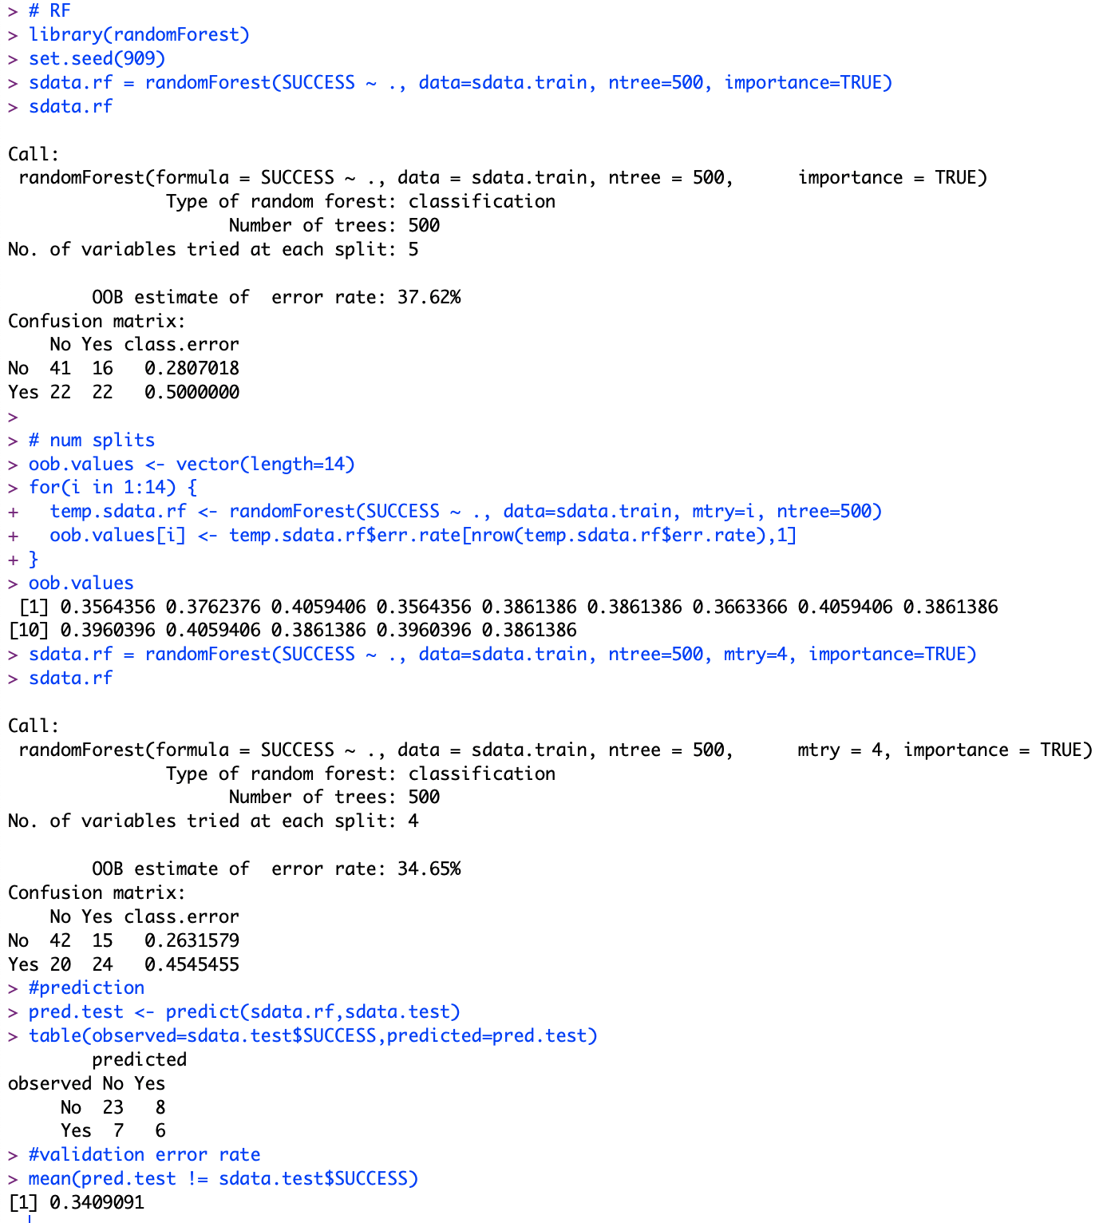
Analysis – Random Forest
500 trees generated
4 mtry features used to build each tree
Out of bag (OOB) estimated error rate is 34.65%
Validation error rate is 34.1%

Slide 20
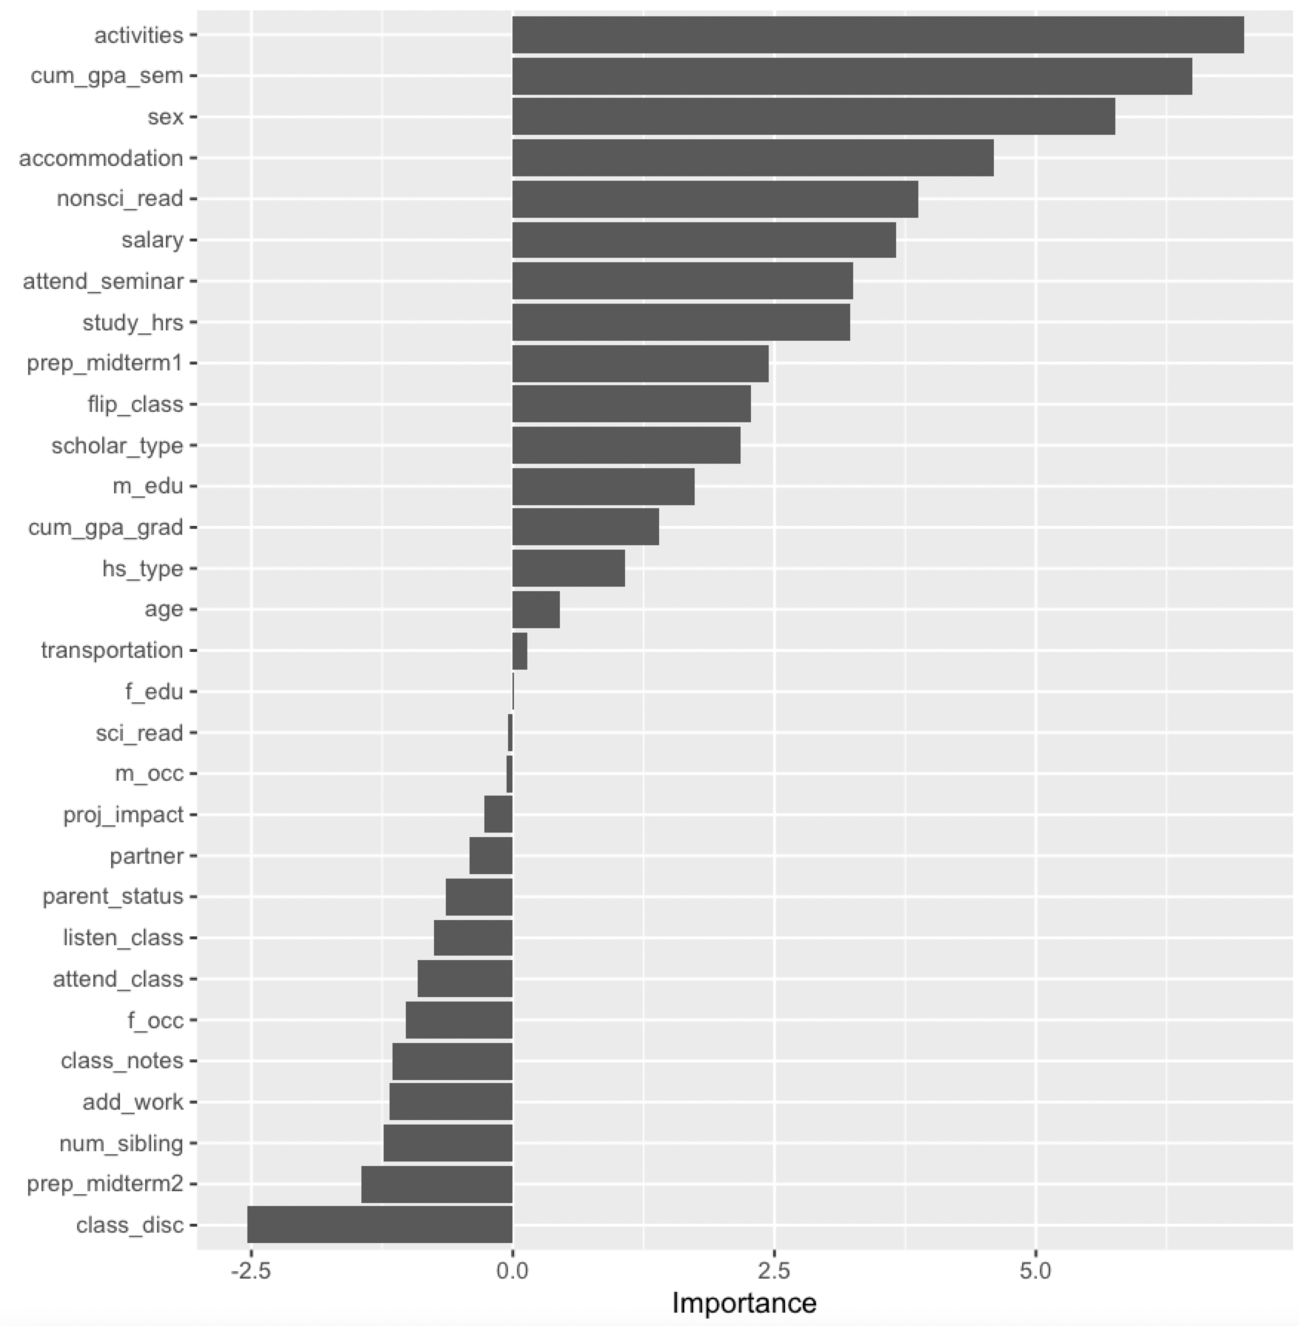
Analysis – Random Forest, continued
Running vip(sdata.rf, num_features=30) returns a plot of the random forest model’s feature importance
Running importance(sdata.rf, type=1)returns a list of predictors and their mean decrease accuracy (estimate of the loss in prediction performance when a predictor is omitted from the training set)
Predictor | Mean Decrease Accuracy
activities | 6.983879552
cum_gpa_sem | 6.495874670
sex | 5.759228563

Slide 21
Summary of Analysis
Decision Tree Type | # of Nodes | Misclassification (training) | Validation Error Rate (test)
Full Data Set | 17 | 10.34% | NA
Train/Test Split (70/30) | 14 | 16.38% | 50%
Pruning – Option 1 | 7 | 19.8% | 45.4%
Pruning – Option 2 | 9 | 16.83% | 47.72%
Random Forest | OOB (training) | Validation Error Rate (test)
500 trees, 4 mtry | 34.65% | 34.1%
Cumulative GPA from previous semester was the most important predictor in the decision tree models.
Activities (followed by Cumulative GPA) was the most import predictor on the random forest model.
Interestingly, Activities does not appear in the decision tree models.

Slide 22
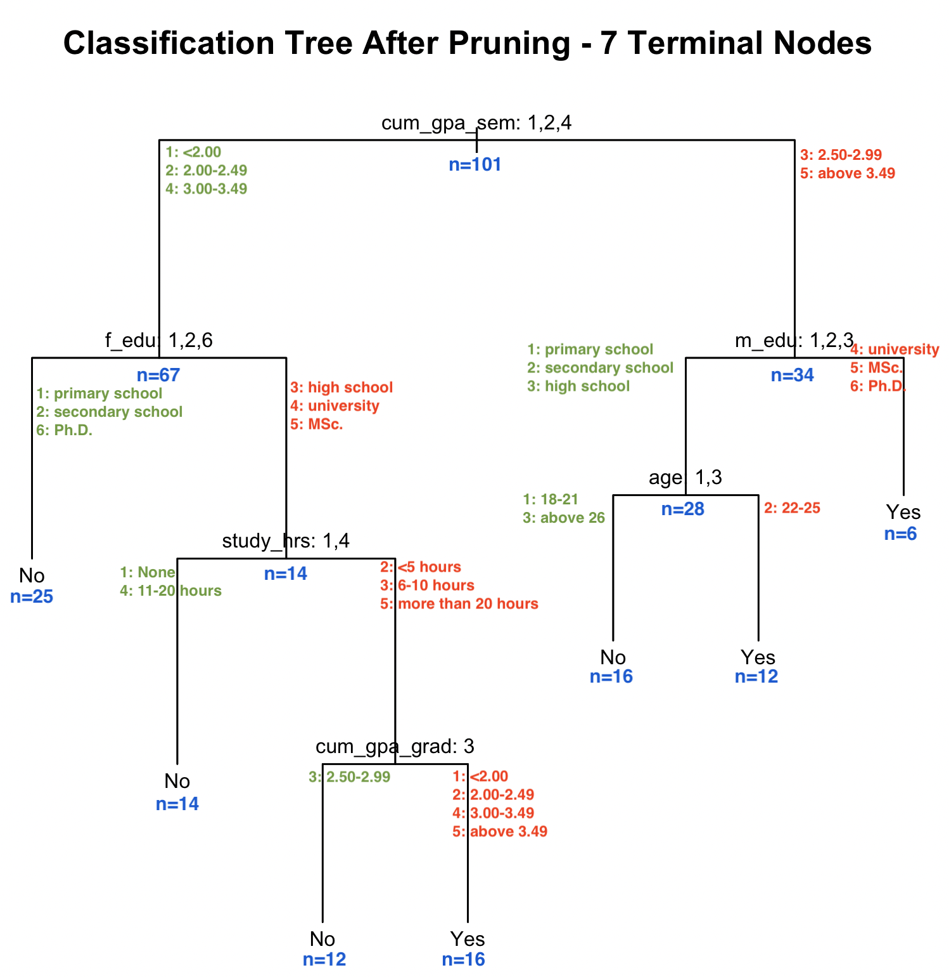
Conclusion
Out of all decision tree options, pruning the tree down to 7 terminal nodes seemed to be the best.
Easiest to read out of the options (9, 14, and 17 terminals nodes)
Lowest validation error rate – 45.4%
While the decision tree depicts a clear picture of the predictors and paths that lead to student success and failure, the high validation error rate cannot be ignored.
Using an ensemble of decision trees – a random forest – seems to be a better option for this dataset – with minimal tuning, we were able to generate a lower validation error rate at 34.1%.
Using data like mean decrease accuracy and visualizations like the variable importance plot can help to tell the story of the data.
N-values from prune.sdata.7$frame

